Slide 1

Netflix Case Study: An Analysis of Content Popularity
Simran Karamchandani
22APR2025

Slide 2
Streaming Upward – Netflix Has Gained Millions
Netflix Subscriber Growth
Data collected by Business of Apps
Highest (36%) Increase in Subscribers in 2012

Slide 3








Customer Perspective – Netflix Has Rapidly Evolved
Online Streaming
Offline Streaming
Price Hikes
Advertisement
2011
2014-2016
2018
2007
2012-2013
2017
2021
DVD Service
Global
Expansion
Interactive
Content
Account Sharing
Restrictions

Slide 4
Data Preparation to Understand the Netflix Profile
8,807 records across 2008-2021
Data Cleaning
Missing Values: Null Threshold & Imputations Applied
No duplicate records identified
Exploratory Data Analysis & Feature Engineering
12 features originally tracked
Show_ID Date_Added
Type: Movie/TV Show Release_Year
Title Rating
Director Duration
Cast Genre: Listed_In
Country Description
Feature Engineer – 7 additional variables
19 features

Slide 5
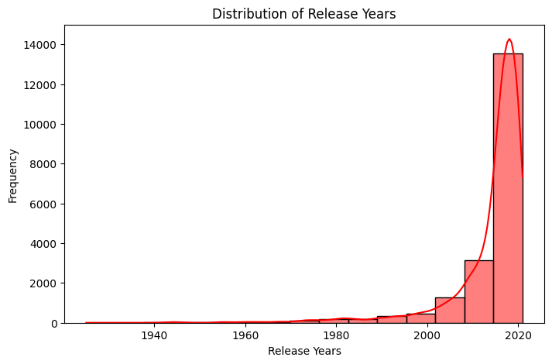
Amid the 2020 Pandemic Chaos Netflix Produced Entertaining Content
Top 5 Popular Movie Genres
International – 23.8% of viewers
Dramas – 21.0% of viewers
Comedies – 14.5% of viewers
Documentaries – 7.5% of viewers
Action & Adventure – 7.4% of viewers
Most viewed content from 2020 as the pandemic encouraged streaming platforms
Top 5 Popular TV Genres
International – 26.7% of viewers
Dramas – 15.1% of viewers
Comedies – 11.5% of viewers
Crime TV Shows – 9.3% of viewers
Kids TV – 8.9% of viewers

Slide 6
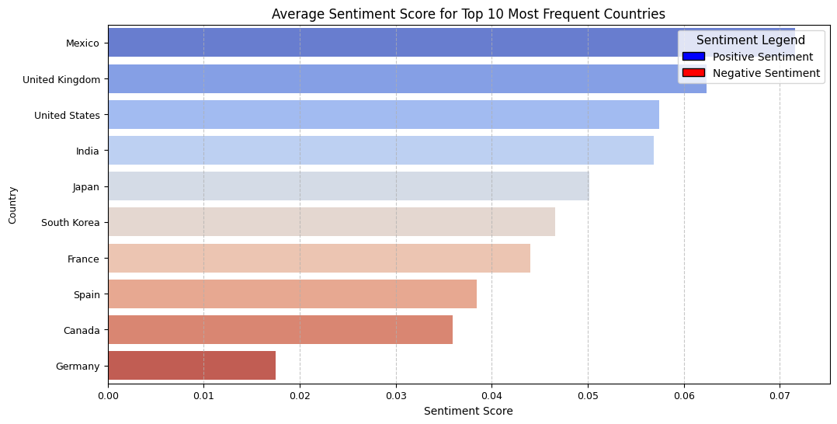
And During this Time, Global Viewers were Mostly Interested in Positive Content
Positive:
(e.g. heartwarming, uplifting)
Mexico, United Kingdom, United States, India
Neutral:
Japan, South Korea
Negative:
(e.g. angry, pessimistic)
France, Spain, Canada, Germany

Slide 7
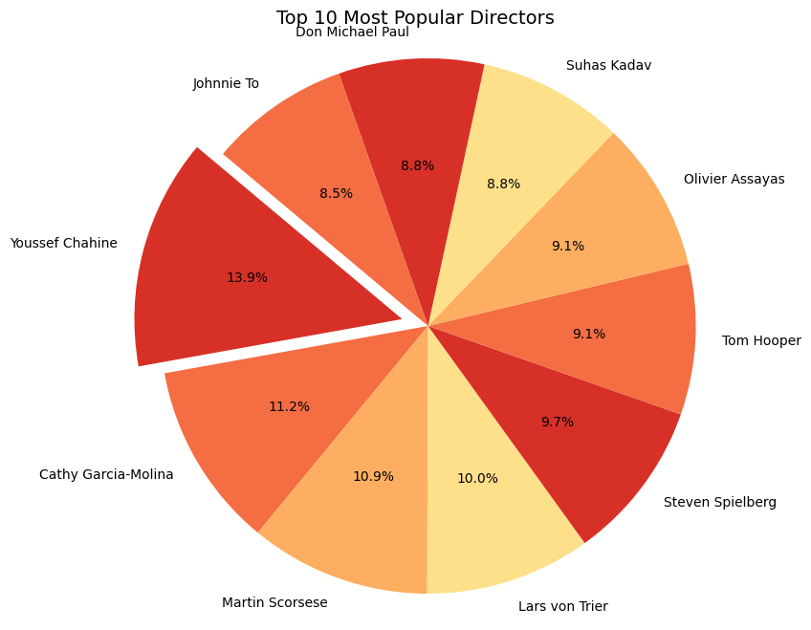
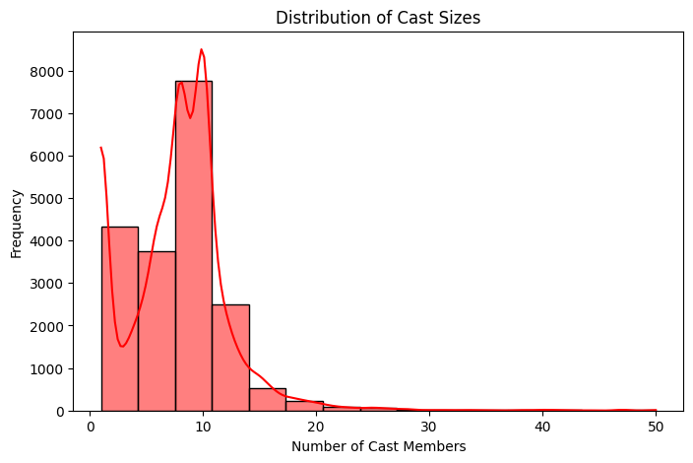
Viewers’ Interests Extended to Diverse Directors’ Signature Styles and Ensemble Casts
Diverse group of directors, indicating global viewing
Most content viewed has a smaller number of cast members, indicating stronger storylines

Slide 8
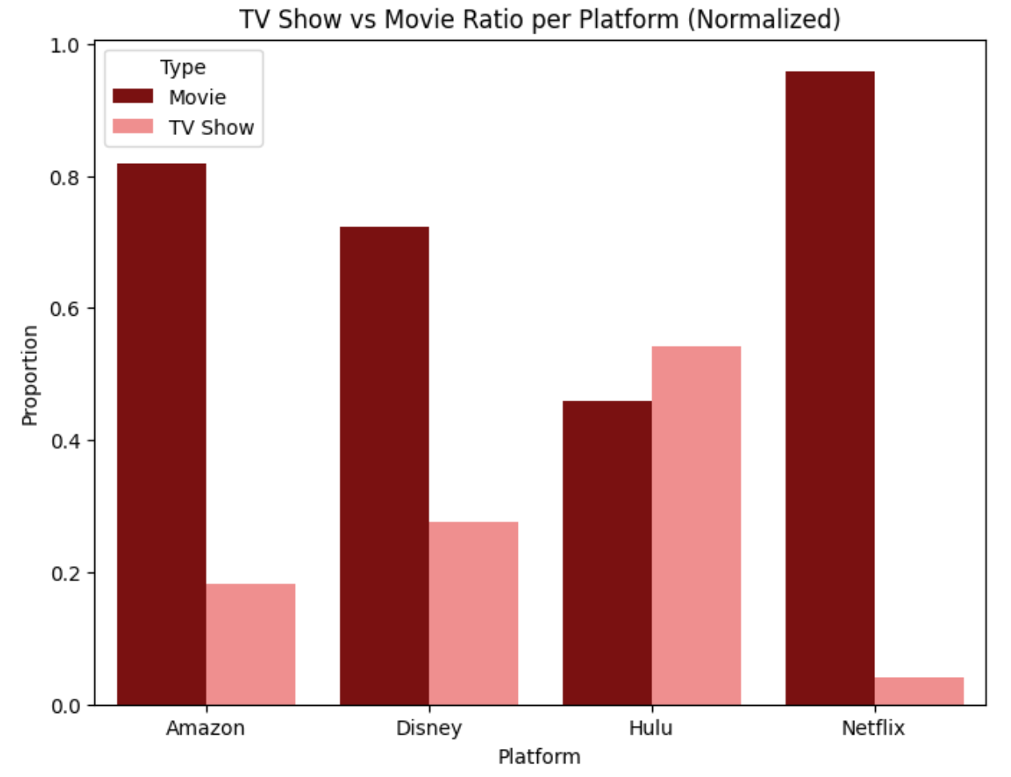
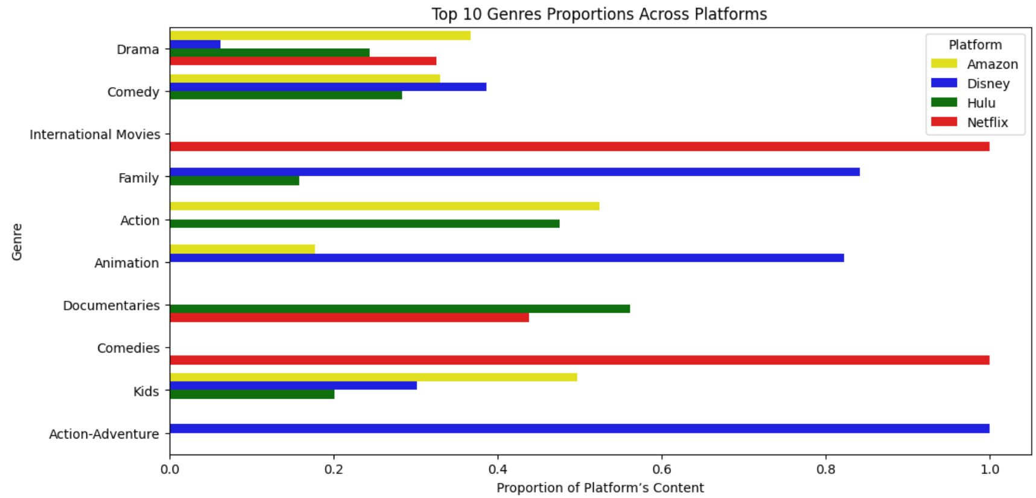
Audiences are Drawn to Netflix’s Movie Content
Netflix overpowers in movie content – especially international movies and comedies compared to competing platforms.

Slide 9


Insights & Future Actions
Netflix increased available content in response to the pandemic
Netflix expanded and globally and released diverse content
Majority of global viewing relied heavily on positive content
Variables to explore for additional insight
Number of views per title
Social Media Mentions
Viewer Demographics
Watch Duration
Viewer Content Reviews
Content Retention Rate

